Slide 1

JBIG
SEMINAR
딥러닝 팀

Slide 2
JBIG
CONTENTS
SEMINAR
01. Project Summary
02. Code reiview
03. Data Analysis
04. Experimental method

Slide 3
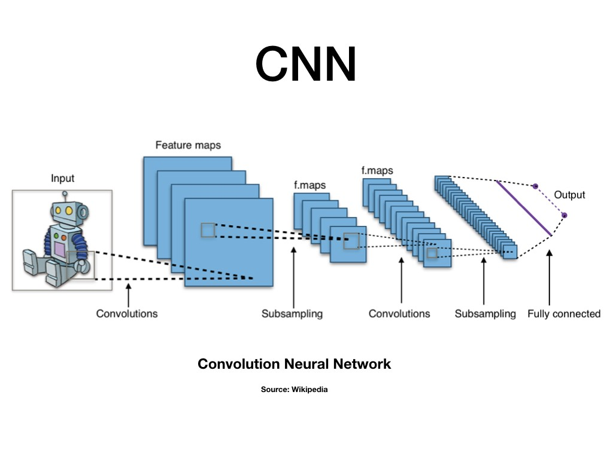
01
초기 Project
SEMINAR
Purpose : Design Classification deep learning model with CNN
Dataset : URL (Corona Chest X-ray images)

Slide 4
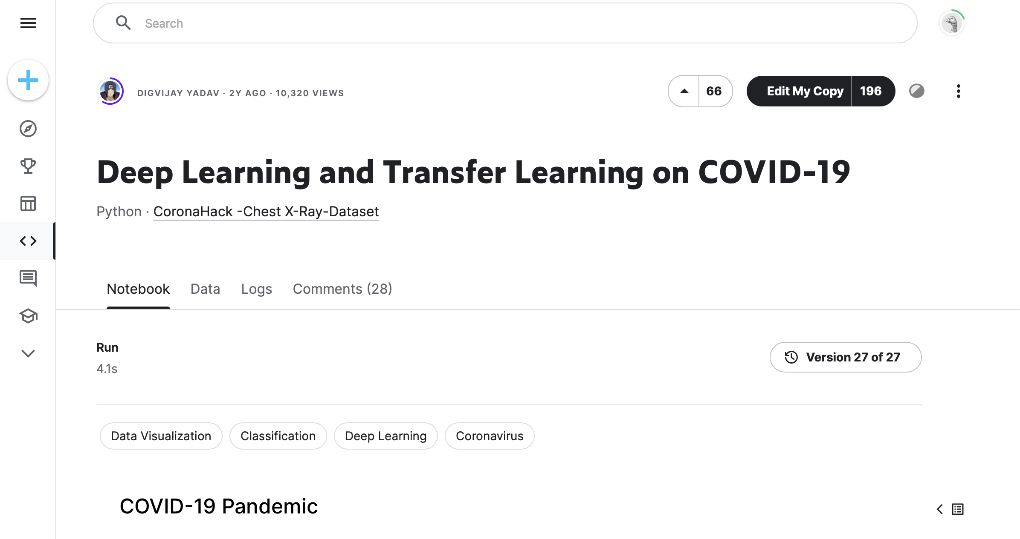
01
초기 Project
SEMINAR
Code example : URL

Slide 5
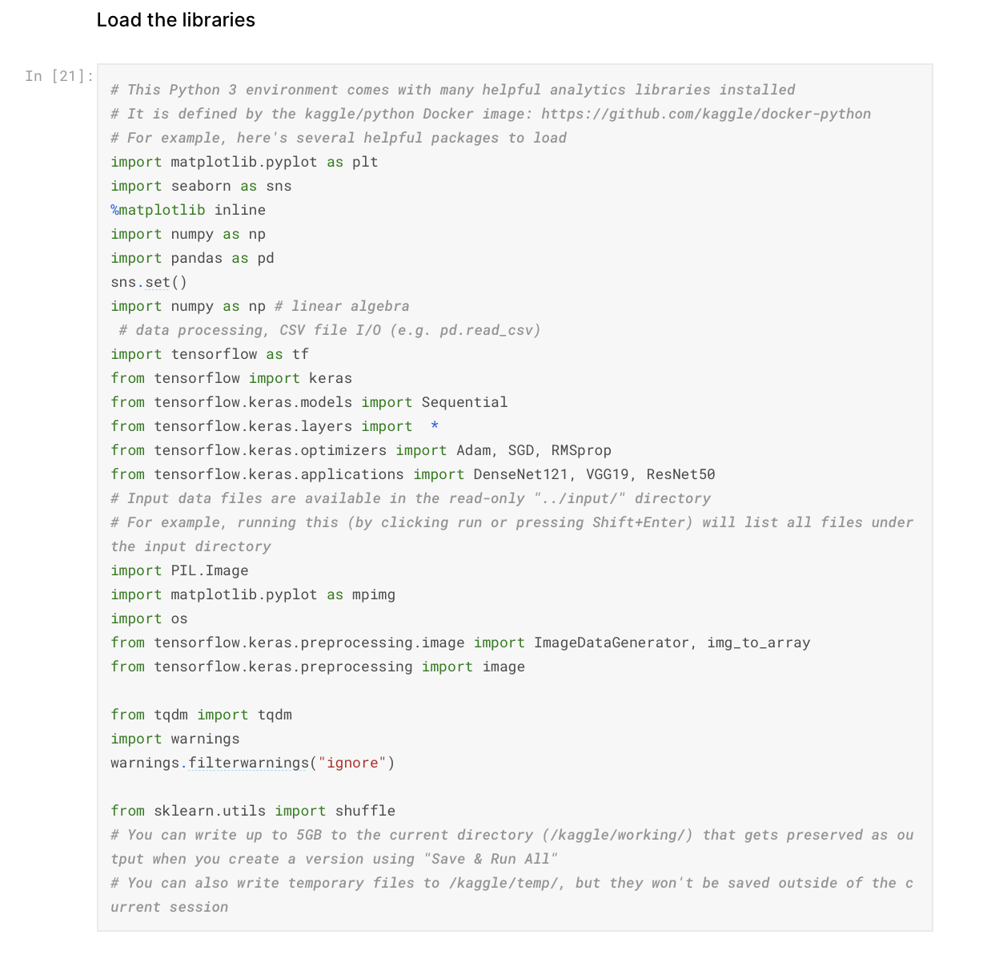
02
Code Reiview
SEMINAR
Used lib
matplotlib.pyplot
Pandas
Tensorflow
Tqdm
Seaborn (based on matplotlib)
OS
numpy

Slide 6
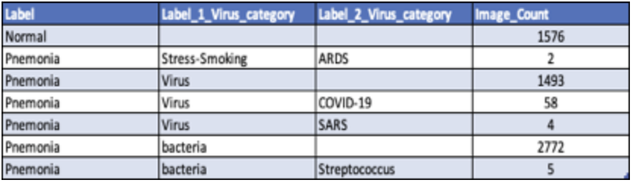
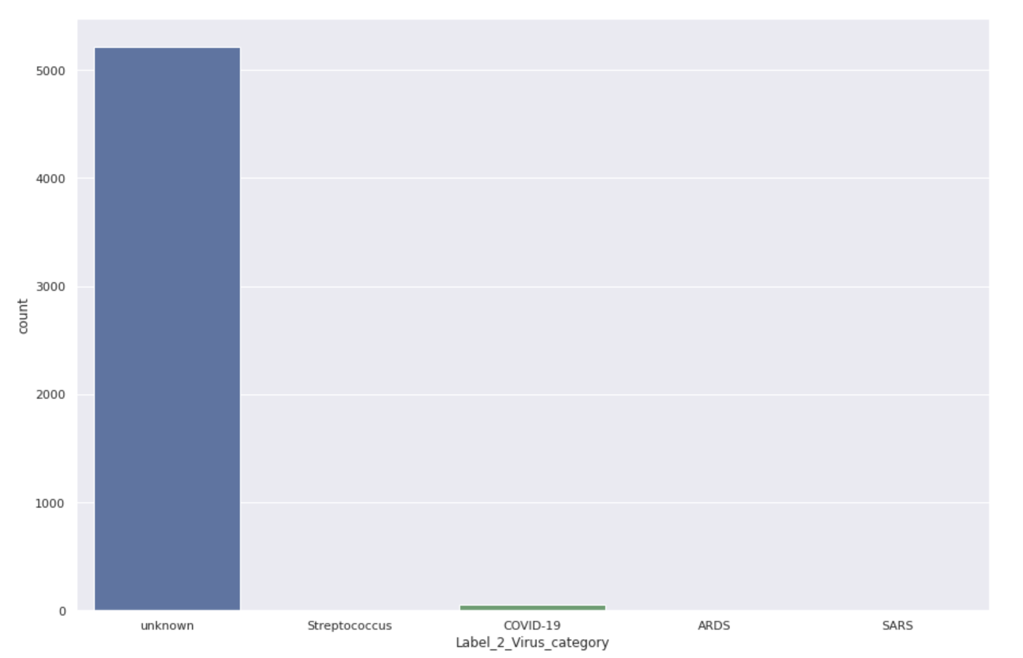
02
Code Reiview
SEMINAR
COVID-19 data are unsufficient!
How to treat this problem ?

Slide 7
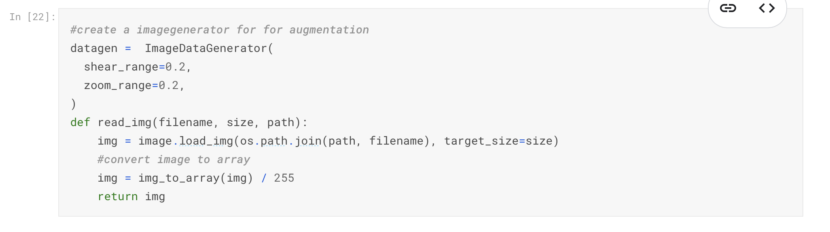
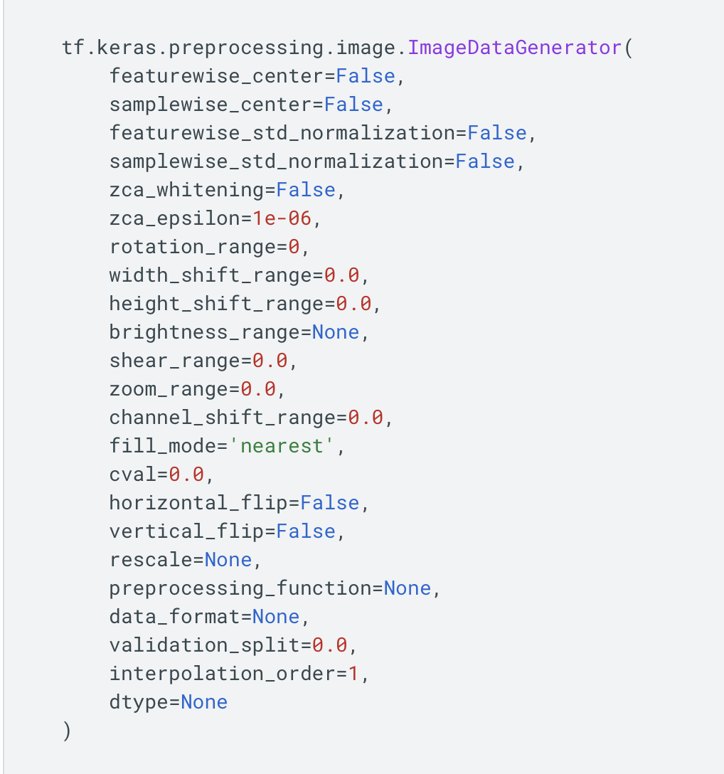
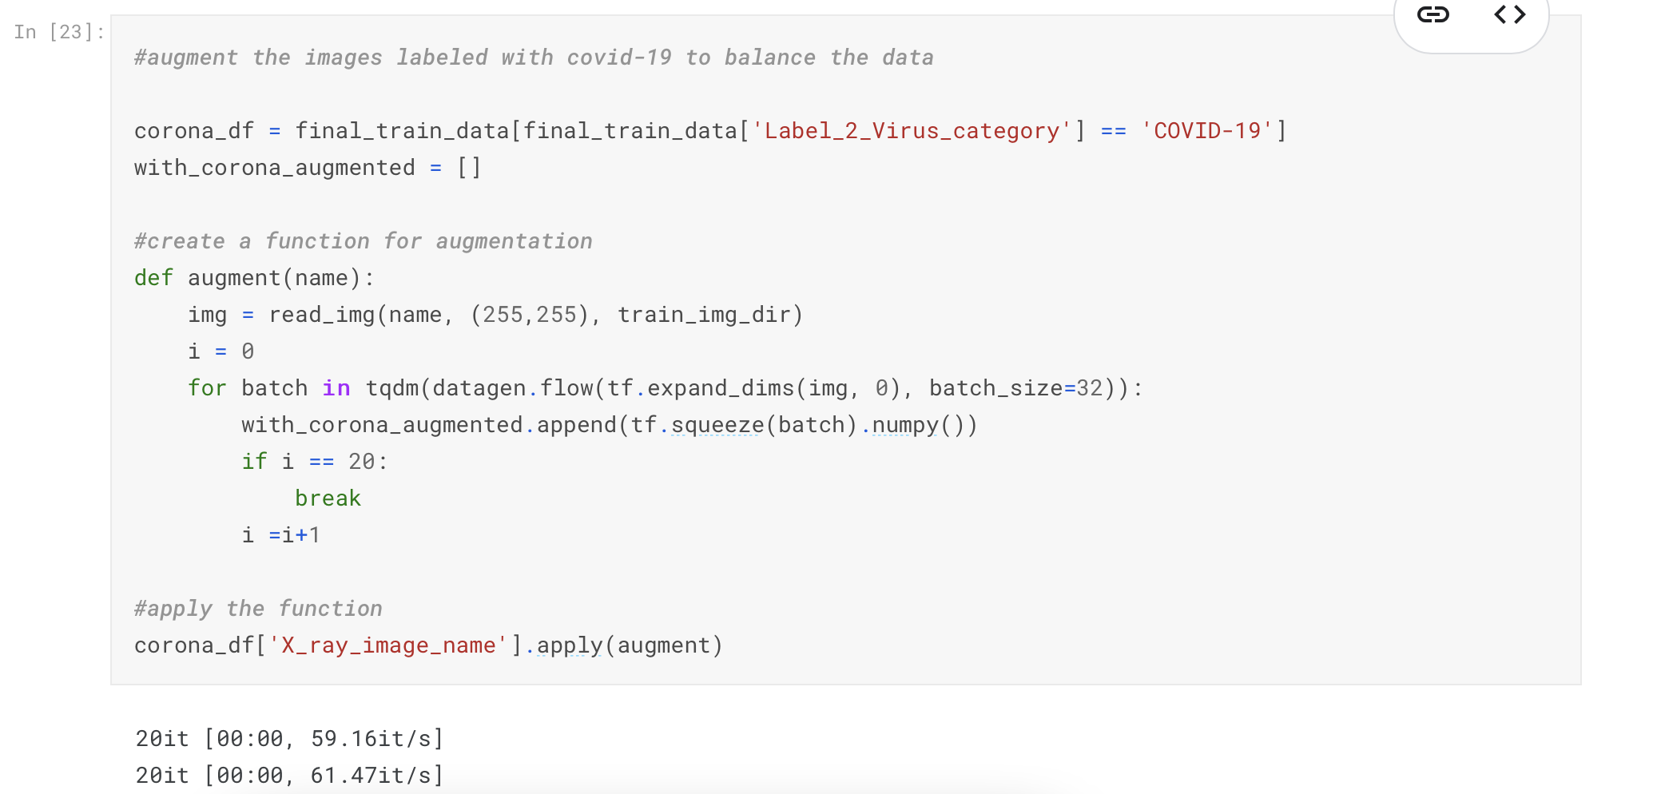
02
Code Reiview
SEMINAR
ImageDataGenerator : URL

Slide 8
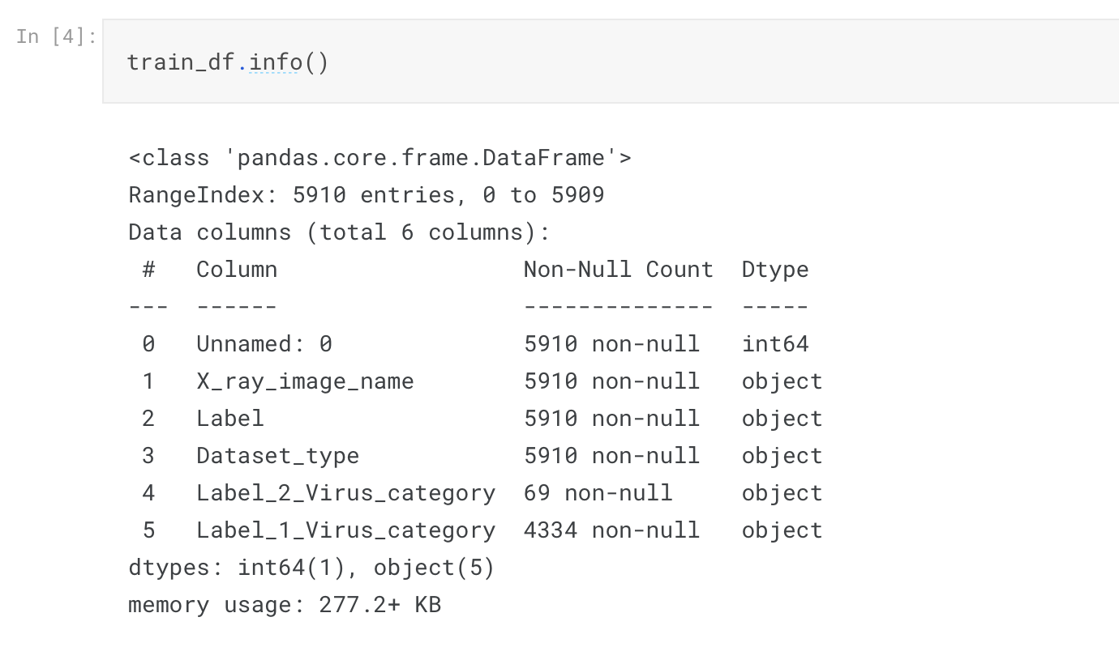
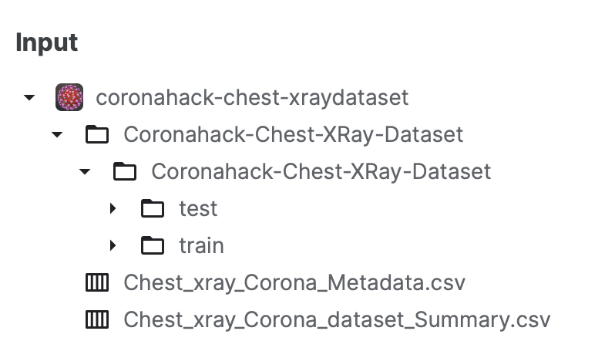
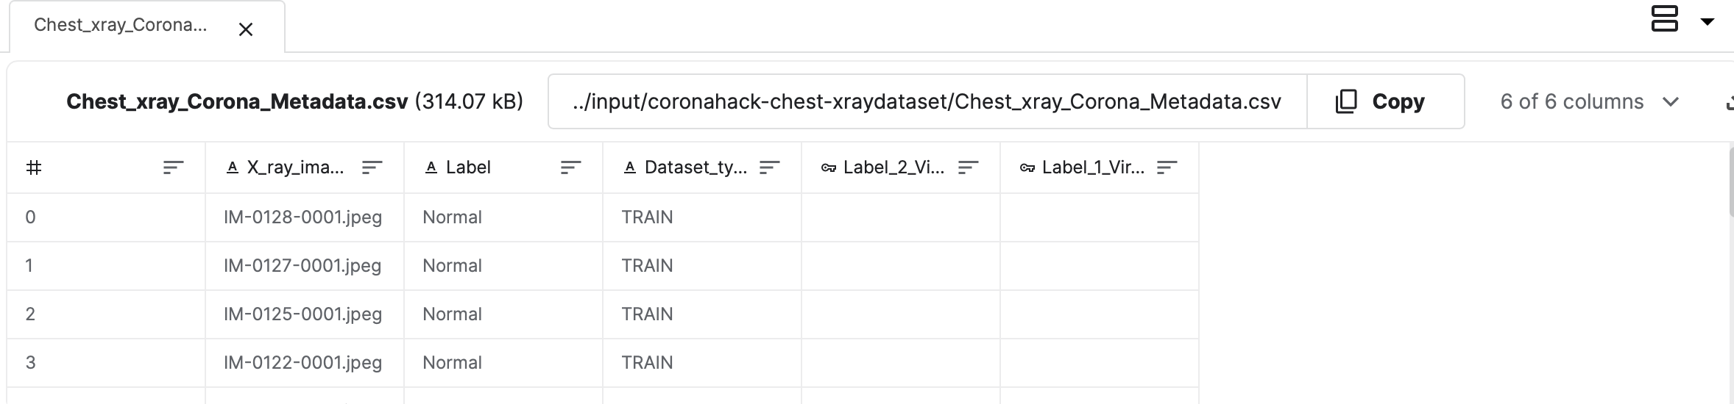
03
Data Analysis
SEMINAR

Slide 9
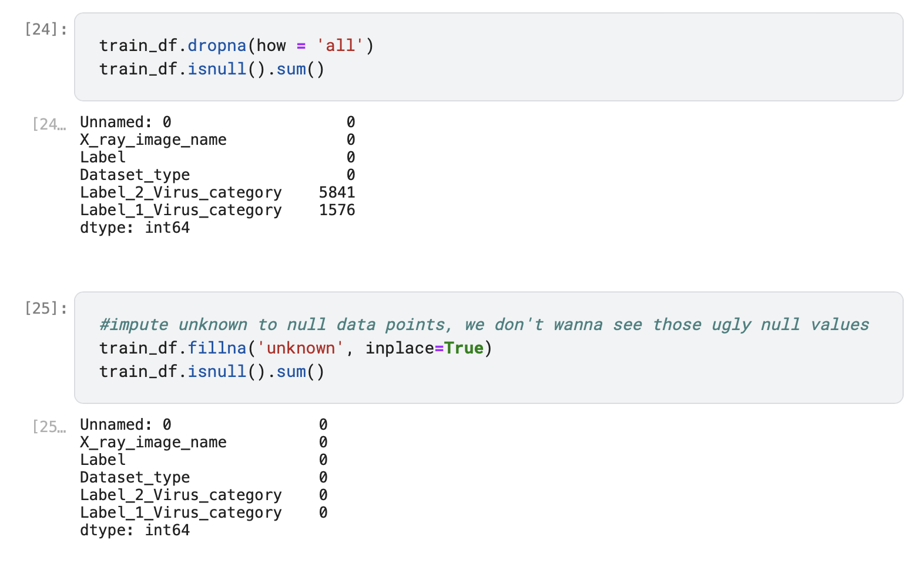
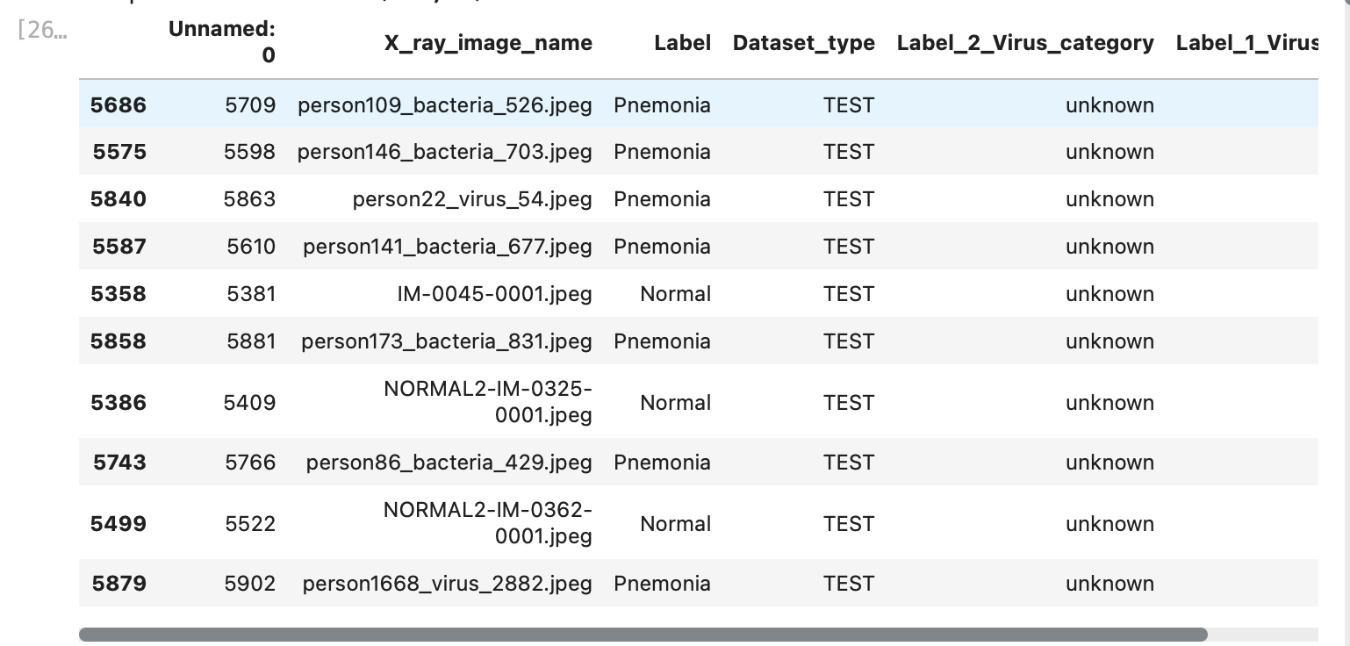
03
Data Analysis
SEMINAR
Remove outlier

Slide 10
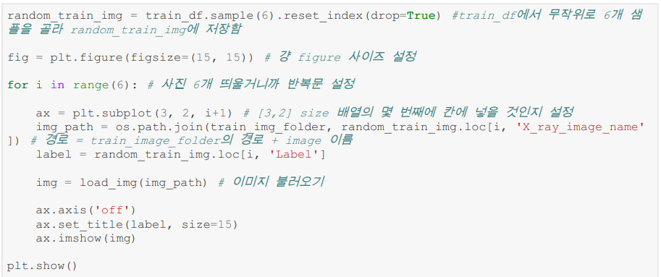
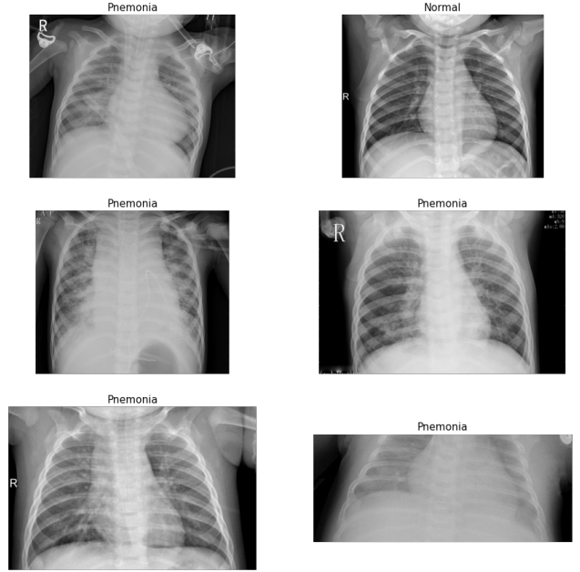
03
Data Analysis
SEMINAR

Slide 11
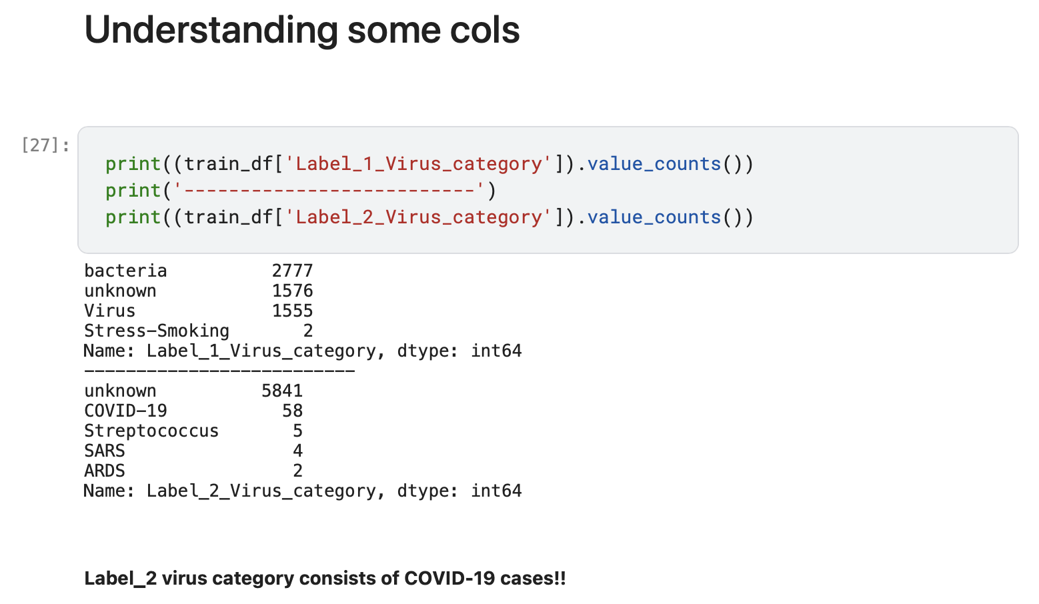
03
Data Analysis
SEMINAR

Slide 12
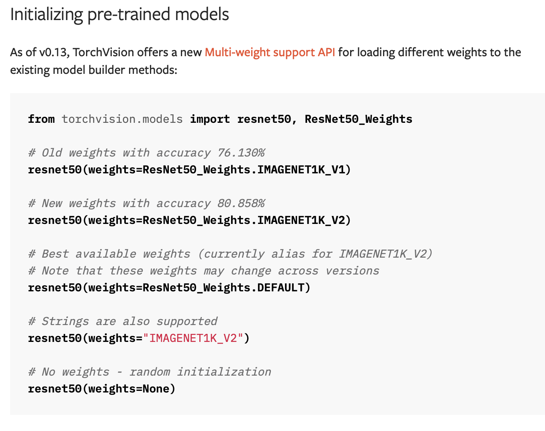
04
Experimental method
SEMINAR
Model : ResNet 50 Pytorch Paper

Slide 13
04
Experimental method
SEMINAR
Learning ResNet 50 with existing data

Slide 14
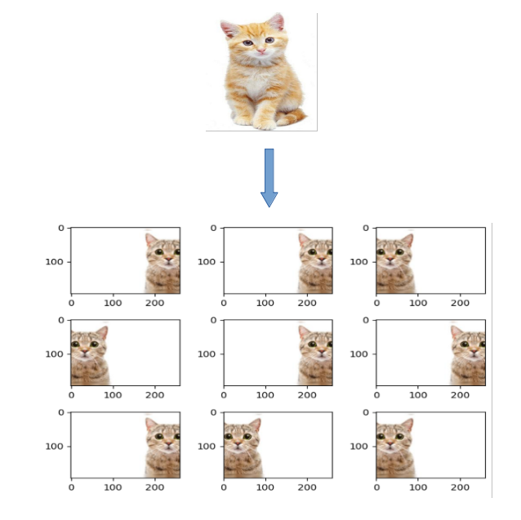
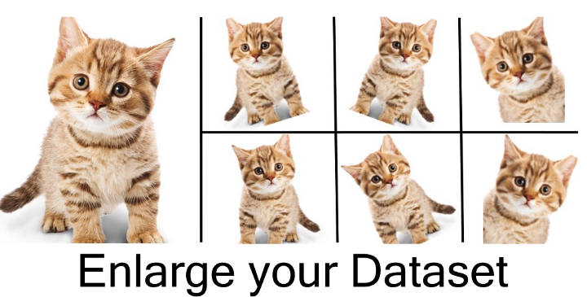
04
Experimental method
SEMINAR
2. Learning ResNet 50 with existing data and Data Augmentation
- tf.keras.preprocessing.image.ImageDataGenerator

Slide 15
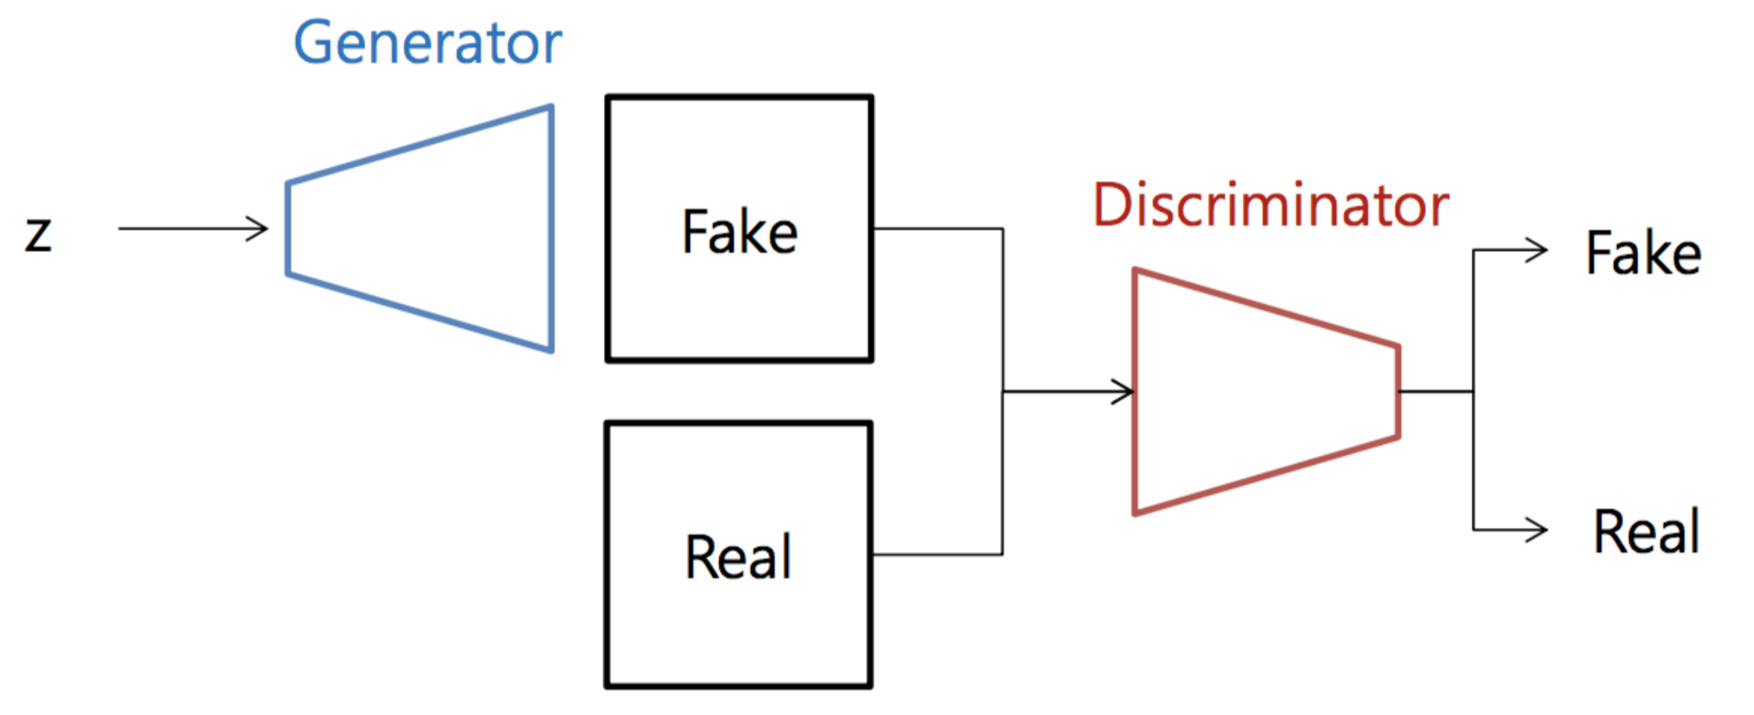
04
Experimental method
SEMINAR
3. Learning ResNet 50 with existing data and Data Augmentation
- Generative Adversarial Network (GAN)

Slide 16
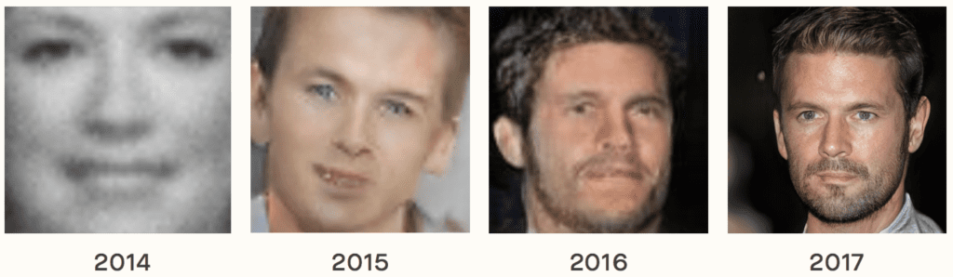
04
Experimental method
SEMINAR

Slide 17
Q&A
Thank you

